Slide 1
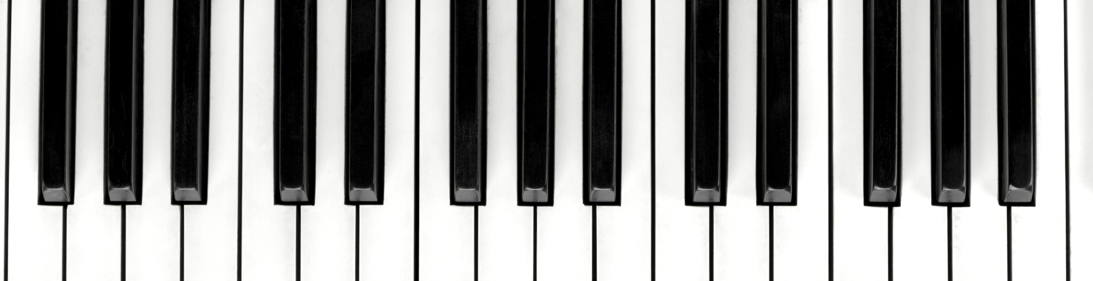
Exploring and Visualizing Personal Music Trends with Spotify
Nithyashree Senguttuvan
Simarjeet Singh

Slide 2

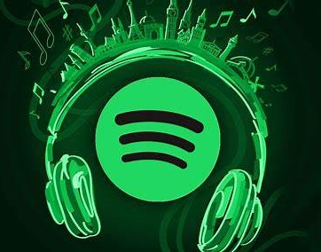
AGENDA
Introduction
Understanding Data: The Spotify Universe
Uncovering Musical Affinities and Dissonances
Unveiling the Network: How Music Data Connects
Visualizing the Musical Journey
Unlocking Insights from Musical Preferences
From Nodes to Notes
Conclusion

Slide 3

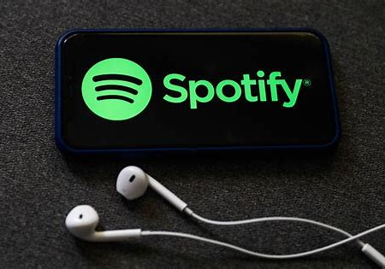

In today's digital age, music streaming platforms like Spotify have seamlessly integrated into the fabric of daily life, catering to a wide spectrum of listeners across different age groups and musical tastes. However, amidst the vast array of music choices, there's a growing need to understand individual preferences and trends.
To tackle this challenge, our project makes use of an innovative methodology that harnesses data analytics and visualization techniques to delve deeper into the intricacies of personal music trends on Spotify.
INTRODUCTION

Slide 4
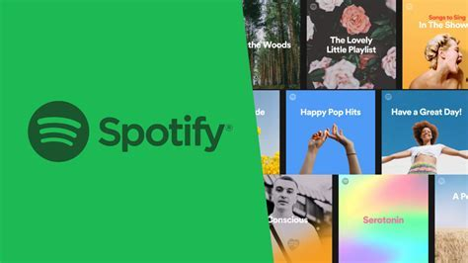

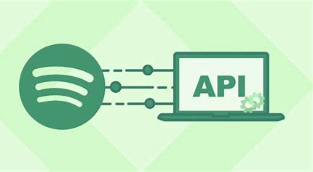

Understanding Data: The Spotify Universe
Requesting from Spotify Application
Typically takes 10 – 30 days
Usually in JSON format and limited data
Playlist Access though URI (uniform resource Indicator).
Instant connection to the playlist.
Can access the playlist data in Realtime.
Available as a part of Web API Dev tools.
Instant Connection.
Can access entire user data in Realtime.
Restricted in time for access.

Slide 5
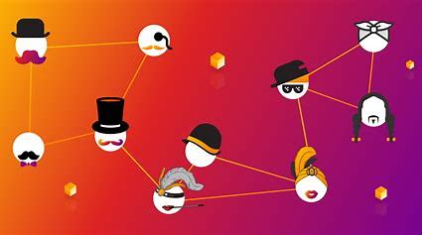

Uncovering Musical Affinities and Dissonances​
Community Detection: Identifying distinct groups or communities within a network where nodes are more densely connected to each other than to nodes in other groups.
Signed Network Analysis: Analyzing networks where connections between nodes are characterized by positive or negative relationships, indicating affinity or aversion.
Visualization of Spotify Data: Employing graphical representations to illustrate patterns, relationships, and trends within Spotify's vast music dataset.

Slide 6
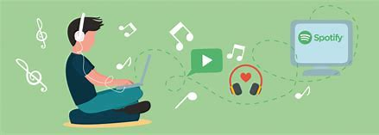

Unveiling the Network: How Music Data Connects
Utilizing all available data from Spotify, we conducted an analysis where nodes represent artists and edges denote transitions between artists by users.
Due to the user-centric focus of our analysis, the data inherently manifests in three dimensions.
Employed the Cluster Walk trap community detection algorithm to derive insights.
Distinguished positive reactions as instances where songs are listened to approximately 90% of their duration.

Slide 7
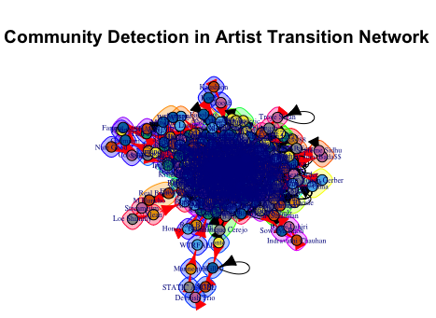

Results – Community Detection

Slide 8
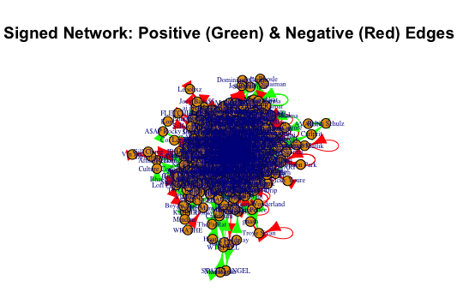

Results – Signed Network Analysis

Slide 9

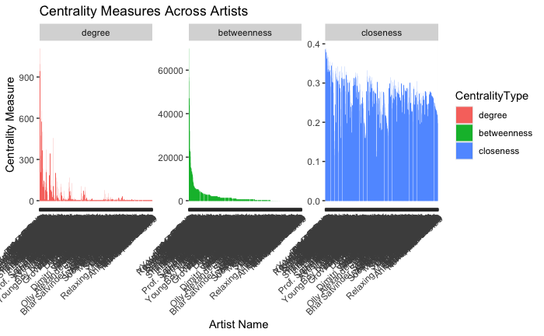
Results – Centrality Measures

Slide 10

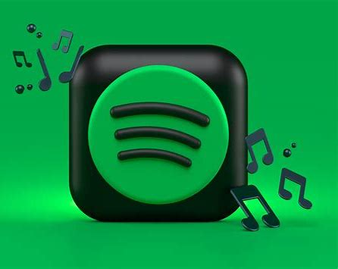
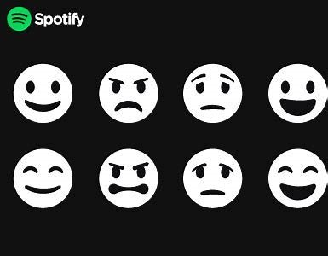
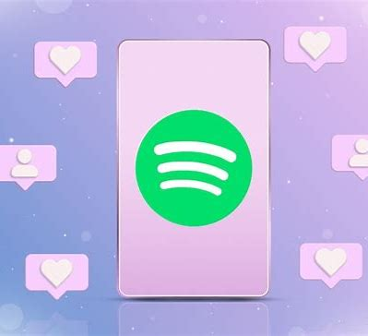

Visualizing the Musical Journey
Usage Stats
Emotional Quadrant
Liked tracks
Danceability

Slide 11

Unlocking Insights from Musical Preferences
Community Detection: Identify clusters of artists with similar music preferences, revealing distinct music communities within the Spotify ecosystem.
Centrality Analysis: Determine influential artists or songs based on their connectivity, shedding light on trends and popular tracks.
Network Robustness: Assess the resilience of the Spotify network to node removal or disruptions, gauging its ability to maintain music recommendations and user interactions.
Music Exploration Pathways: Explore individual user journeys through the Spotify network, offering personalized insights into listening habits and eclectic tastes.

Slide 12
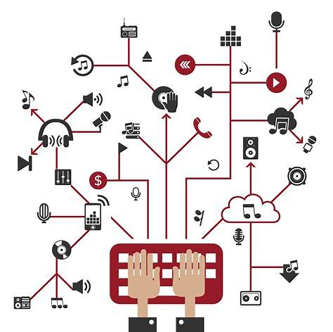

From Nodes to Notes
Dynamic Network Analysis: Explore how user music preferences evolve over time by analyzing temporal changes in network structure.
Sentiment Analysis Integration: To understand user emotions and reactions towards specific songs or artists.
Incorporation of Contextual Data: Enhance analysis by incorporating contextual data such as user demographics, location, or device type.
Predictive Modeling for Music Trends: Develop predictive models to forecast future music trends and user preferences based on historical data.

Slide 13



Conclusion
In conclusion, our exploration and visualization of personal music trends with Spotify have illuminated fascinating insights into user behaviors, music preferences, and community dynamics within the platform. By leveraging advanced techniques, we've uncovered the intricate tapestry of connections between users and artists, providing valuable insights. As we look to the future, there remains boundless potential for further exploration, innovation, and collaboration in unlocking the full spectrum of musical experiences on Spotify.

